Slide 1
Considering a route
Maths and the environment

Slide 2
How our teaching resources are designed for the classroom

Slide 3
I can plan a journey and consider which available form of transport is best.

Slide 4
A quick estimate for a calculation is obtained from using approximate values, often rounded to 1 significant figure.

Slide 5

Considering a route
Planning a direct journey
Planning a journey that includes changeovers

Slide 6

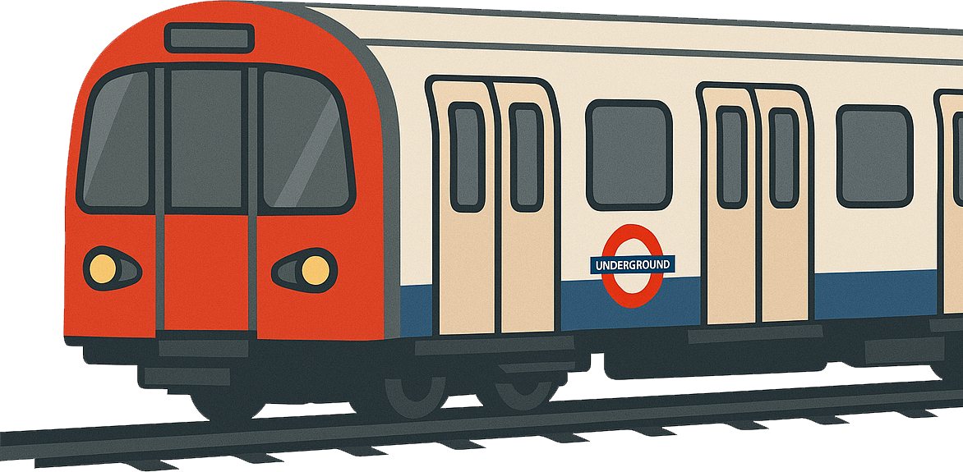

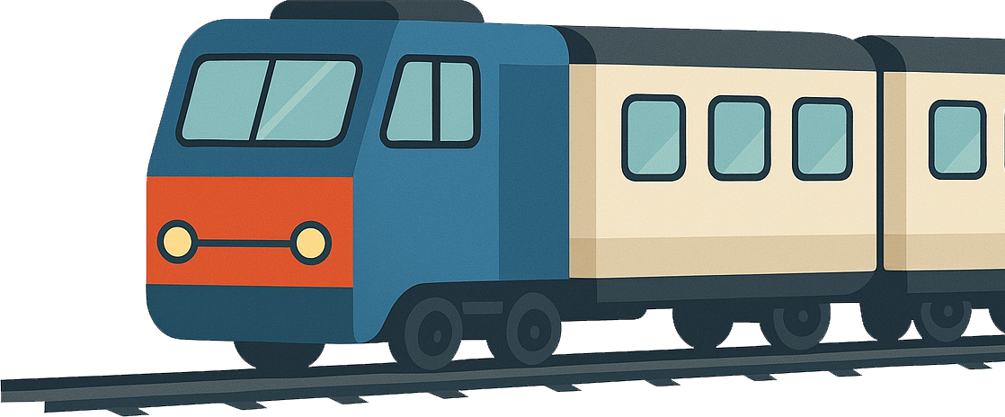
Planning a direct journey
When we plan a journey, there are sometimes multiple options available for the method of transport.
Examples:
car
bus
train
underground train
What factors may affect which mode of transport somebody chooses for their journey?

Slide 7
Planning a direct journey
There are many factors that may affect a person’s choice of transport. Examples include:
the time a journey would take using each mode of transport;
the cost of a journey using each mode of transport;
availability of different forms of public transport in their area;
the availability of car parking spaces;
how much road traffic there may be at the time of travel;
how busy public transport will be at the time of travel;
the environmental impact of each mode of transport.

Slide 8
Planning a direct journey
Journey planners, such as apps or websites, can be helpful for planning a journey.
They can estimate how long a journey could take using different modes of transport, suggest possible routes and which trains/buses you could catch.
While these provide suggested routes, the final decisions about a journey are made by the person who is travelling.
Decisions about modes of transport may depend on factors that are not considered by a journey planner.

Slide 9
Planning a direct journey
Izzy and her father are planning to visit a museum. They are trying to decide whether it would be quicker to travel by car or by bus.
Why might travelling by bus take more time than travelling by car?
They will need to walk to a bus stop.
The bus may take an indirect route.
Buses stop regularly to pick up and drop off passengers.
Why might travelling by bus take less time than travelling by car?
A bus may be able to overtake busy traffic by using a bus lane.
There might not be a car park near the museum.

Slide 10
Planning a direct journey
Another option could be to travel by train.
Why might travelling by train take less time than travelling by bus?
Trains tend to travel faster than buses.
Trains are not affected by road traffic.
Trains have fewer stops compared to a bus journey of the same length.
Why might travelling by train take more time than travelling by bus?
There are fewer railway stations than bus stops, so you may have to walk further to get to/from a railway station.
The trains on a route might be less frequent than buses.

Slide 11
Planning a direct journey
Izzy and her father are planning to visit a museum. They consider how much time it would take to travel by bus.
The nearest bus stop to their home is a 10-minute walk away. They would board the bus at 13:42 and alight at 14:13. The nearest bus stop to the museum is a 5-minute walk away.
What would be the total journey time?
13:42
14:00
14:13
+18
+13
Time spent on the bus: 18 + 13 = 31 minutes
Time spent walking: 10 + 5 = 15 minutes
Total journey time: 31 + 15 = 46 minutes

Slide 12
Planning a direct journey
Izzy and her father are planning to visit a museum. They consider how much time it would take to travel by car.
The nearest car park to the museum is a 20-minute walk away. It would take 25 minutes to drive to the car park.
What would be the total journey time?
20 + 25 = 45 minutes

Slide 13
Planning a direct journey
Izzy and her father are planning to visit a museum. They consider how much time it would take to travel by train.
The nearest railway station to their home is a 20-minute walk away. They would board the train at 13:56 and alight at 14:05. The nearest railway station to the museum is a 10-minute walk away.
What would be the total journey time?
Time spent on the train: 4 + 5 = 9 minutes
Time spent walking: 20 + 10 = 30 minutes
Total journey time: 30 + 9 = 39 minutes

Slide 14
Planning a direct journey
Izzy and her father consider how much a journey would cost to travel by car.
A journey planner says that the car park is 6.8 miles away from their home. On average, their car travels 40 miles per gallon of petrol. At their nearest petrol station, petrol is sold for 142.9 p per litre. 1 gallon ≈ 4.546 litres.
What would be the cost of petrol required for the journey?
Petrol used in 1 mile: 1 ÷ 40 = 0.025 gallons
Petrol used in 6.8 miles: 0.025 × 6.8 = 0.17 gallons
Convert to litres: 0.17 × 4.546 = 0.77282 litres
Cost of petrol: 0.77282 × 142.9 = 110.435… p ≈ £1.10

Slide 15
Planning a direct journey
The petrol for a one-way journey would cost £1.10. Parking in the car park would cost £7.40. They would also need to drive home.
What would be the total cost of travelling by car?
1.10 × 2 + 7.40 = £9.60

Slide 16
Planning a direct journey
They consider how much it would cost to travel by bus.
Adult bus tickets cost £3 each way. Children bus tickets cost £1.50 each way.
What would be the total cost of one adult and one child traveling there and back by bus?
(3 + 1.50) × 2 = £9

Slide 17
Planning a direct journey
A car travels an average of 50 miles per gallon.
How many gallons of petrol would it use per mile?
1 ÷ 50 = 0.02 gallons
How many gallons of petrol would it use in 15 miles?
0.02 × 15 = 0.3 gallons
1 gallon ≈ 4.546 litres. How many litres is equal to 0.3 gallons?
0.3 × 4.546 = 1.3638 litres

Slide 18
Planning a direct journey
A petrol stations charges 151.9 p per litre for petrol. A one-way journey requires 1.3638 litres of petrol.
What is the cost of petrol for the journey?
1.3638 × 151.9 = 207.16122 p
≈ £2.07
A car park charges £6.20. What would be the total cost of a two-way journey with parking?
2.07 × 2 + 6.20 = £10.34

Slide 19
Planning a direct journey
1) Jacob (aged 14) and his mother are planning to travel to a theatre in a city centre.
They want to arrive at the theatre by 2:45pm.
They consider travelling by bus.
The nearest bus stop is on Oak Road, which is a 5-minute walk from their home.
The bus stops directly outside the theatre.
A journey planner app says that a bus will depart from Oak Road at 1:48pm and arrive at the theatre at 2:36pm.
A single-way ticket on the bus costs £2 per adult and £1.20 per child (under 19).
a) What is the latest time they can leave their home if they travel by bus?
b) What is the total cost of the journey to travel there and back by bus?

Slide 20
Planning a direct journey
2) Jacob and his mother are planning to travel to a theatre in a city centre.
They want to arrive at the theatre by 2:45pm.
They consider travelling by car.
The nearest car park to the theatre is a 15-minute walk away.
A journey planner app says that the car park is 9 miles from their home and will take 35 minutes to drive to.
It will cost £5.50 to park in the car park.
On average, their car travels 45 miles per gallon.
At their nearest petrol station, petrol is sold for 148.9 p per litre.
1 gallon ≈ 4.546 litres.
a) What is the latest time they can leave their home if they travel by car?
b) What is the total cost of the journey to travel there and back by car?

Slide 21
Planning a direct journey
3) Use a journey planning website to plan a journey. The journey should be from your home to a destination that you could travel to directly by public transport (e.g. bus, train, underground).
Plan how you could make the journey by car and by public transport. Compare the time and cost implications of each.
You may wish to consider the following points:
the distance between your home and where you would board the transport;
the distance between where you would exit the transport and your destination;
the time you would spend travelling in the transport;
cost of a ticket on public transport;
the cost of parking the car (if unsure, you could use £5.50 as an estimate);
the cost of petrol by the car (if unsure, you could use the same as in Q2).

Slide 22
Planning a direct journey
1) Jacob (aged 14) and his mother are planning to travel to a theatre in a city centre.
They want to arrive at the theatre by 2:45pm.
They consider travelling by bus.
The nearest bus stop is on Oak Road, which is a 5-minute walk from their home.
The bus stops directly outside the theatre.
A journey planner app says that a bus will depart from Oak Road at 1:48pm and arrive at the theatre at 2:36pm.
A single-way ticket on the bus costs £2 per adult and £1.20 per child (under 19).
a) What is the latest time they can leave their home if they travel by bus?
1:43pm
b) What is the total cost of the journey to travel there and back by bus?
(2 + 1.20) × 2 = £6.40

Slide 23
Planning a direct journey
2) Jacob and his mother are planning to travel to a theatre in a city centre.
They want to arrive at the theatre by 2:45pm.
They consider travelling by car.
The nearest car park to the theatre is a 15-minute walk away.
A journey planner app says that the car park is 9 miles from their home and will take 35 minutes to drive to.
a) What is the latest time they can leave their home if they travel by car?
Total journey time: 15 + 35 = 50 min
Depart by: 1:55pm

Slide 24
Planning a direct journey
A journey planner app says that the car park is 9 miles from their home.
It will cost £5.50 to park in the car park.
On average, their car travels 45 miles per gallon.
At their nearest petrol station, petrol is sold for 148.9 p per litre.
1 gallon ≈ 4.546 litres.
b) What is the total cost of the journey to travel there and back by car?
.
Gallons of petrol used in 1 mile:
Gallons of petrol used in 18 miles:
Litres of petrol used in 18 miles:
Cost of petrol:
Total cost:
1 ÷ 45 = 0.02 gallons
.
0.02 × 18 = 0.4 gallons
0.4 × 4.546 = 1.8184 litres
1.8184 × 148.9 = 270.75976 p ≈ £2.71
2.71 + 5.50 = £8.21

Slide 25
Planning a direct journey
3) Use a journey planning website to plan a journey.
The journey should be from your home to a destination that you could travel to directly by public transport (e.g. bus, train, underground).
Plan how you could make the journey by car and by public transport.
Compare the time and cost implications of each.
You may wish to consider the following points:
the distance between your home and where you would board the transport;
the distance between where you exit the transport and your destination;
the time you would spend travelling in the transport;
cost of a ticket on public transport;
the cost of parking the car (if unsure, you could use £5.50 as an estimate);
the cost of petrol by the car (if unsure, you could use the same as in Q2).
Answers will vary depending on pupils’ choices.

Slide 26
Considering a route
Planning a direct journey
Planning a journey that includes changeovers

Slide 27
Planning a journey that includes changeovers
Not all journeys on public transport can be made directly.
Sometimes you may need to use multiple vehicles in a single journey.
bus
start
destination
1st bus
1st train
bus
2nd bus
2nd train
another location
train
A stage of a journey where we change between trains/buses is sometimes referred to as a connection or a changeover.

Slide 28
Planning a journey that includes changeovers
A journey that requires a changeover means that additional considerations may be needed to plan the journey.
You need to consider the amount of time between alighting from one vehicle and boarding the next vehicle (changeover time).
start
destination
1st train
2nd train
30 min
45 min
changeover
15 min
Total journey time = 30 + 15 + 45
= 90 min (1 hour 30 min)

Slide 29
Planning a journey that includes changeovers
It may be preferable to have a short changeover time.
However, this increases the risk of missing the connection.
start
destination
1st train
2nd train
30 min
45 min
changeover
4 min
Total journey time = 30 + 4 + 45
= 79 min (1 hour 19 min)

Slide 30

Planning a journey that includes changeovers
It may be preferable to have a short changeover time.
However, this increases the risk of missing the connection. E.g. Alex’s 1st train arrives 5 minutes late causing him to miss the 2nd train. He then has to wait another 29 minutes for the next train.
start
destination
1st train
2nd train
30 min
45 min
changeover
35 min
4 min
29 min
Total journey time = 35 + 29 + 45
= 109 min (1 hour 49 min)

Slide 31

Planning a journey that includes changeovers
Aisha wants to travel from Town A to Town C. She plans to catch the 16:55 bus from Town A to Town B. The bus stop in Town B is a 4 minute walk from the train station. She then plans to catch the next train from Town B to Town C.
Bus times:
Town A | 16:55 | 17:15
Town B | 17:34 | 17:49
Will she arrive in Town B with enough time to catch the 17:41 train?
Explain your answer.
Train times:
Town B | 17:41 | 18:00
Town C | 18:33 | 18:50
Yes. She has 7 minutes to make her connection, meaning she has 3 minutes to spare.

Slide 32
Planning a journey that includes changeovers
The 16:55 bus arrives in Town B five minutes late.
What time does she arrive in Town C?
Bus times:
Town A | 16:55 | 17:15
Town B | 17:34 | 17:49
She will miss the 17:41 train (unless that is also running late).
So she catches the 18:00 train and arrives in Town C at 18:50.
Train times:
Town B | 17:41 | 18:00
Town C | 18:33 | 18:50

Slide 33
Planning a journey that includes changeovers
1) Sofia has a university interview in an office in London. She needs to arrive at the office before 11am.
The office is a 15-minute walk from London Kings Cross Station. Her nearest train station, Oakington, is a 10-minute walk from her home. The train is not direct. She would need to change trains at Elmsville. Some possible train times are below.
a) What is the latest possible time that Sofia can leave her home to arrive for her interview?
departs Oakington | 07:03 | 07:33 | 08:03
arrives at Elmsville | 07:27 | 07:57 | 08:27
b) What could go wrong if she leaves at the time in part (a)?
departs Elmsville | 07:40 | 08:00 | 08:40
arrives at London | 09:44 | 10:20 | 10:44
c) Suggest a more cautious time that Sofia could leave her home.

Slide 34
Planning a journey that includes changeovers
2) Use a journey planning website to plan a journey.
The journey should be from your home to a destination that you could travel to by public transport. However, the journey should include at least 1 changeover when using public transport (e.g. a bus and then a train).
Plan how you could make the journey by public transport.
You may wish to consider the following points:
the distance between your home and where you would first board transport;
the distance between where you exit the transport and your destination;
the time you would spend travelling during each stage of the journey;
the amount of time during your changeover;
the total amount of time for the entire journey;
cost of a ticket on the public transport for each stage of the journey.

Slide 35
Planning a journey that includes changeovers
1) Sofia has a university interview in an office in London. She needs to arrive at the office before 11am.
The office is a 15-minute walk from London Kings Cross Station. Her nearest train station, Oakington, is a 10-minute walk from her home. The train is not direct. She would need to change trains at Elmsville. Some possible train times are below.
a) What is the latest possible time that Sofia can leave her home to arrive for her interview?
departs Oakington | 07:03 | 07:33 | 08:03
arrives at Elmsville | 07:27 | 07:57 | 08:27
07:53
Leave home at 07:53. Catch 08:03 train from Oakington. Catch 08:40 train from Elmsville. Arrive at office at 10:59.
departs Elmsville | 07:40 | 08:00 | 08:40
arrives at London | 09:44 | 10:20 | 10:44

Slide 36
Planning a journey that includes changeovers
departs Oakington | 07:03 | 07:33 | 08:03
arrives at Elmsville | 07:27 | 07:57 | 08:27
b) What could go wrong if she leaves at the time in part (a)?
E.g. The train from Elmsville to London could be delayed.
departs Elmsville | 07:40 | 08:00 | 08:40
arrives at London | 09:44 | 10:20 | 10:44
c) Suggest a more cautious time that Sofia could leave her home.
Example 1:
Leave home at 07:23. Catch 07:33 train from Oakington. Catch 08:00 train from Elmsville. Arrive at office at 10:35.
However, this only gives Sofia 3 minutes to change trains in Elmsville.

Slide 37
Planning a journey that includes changeovers
departs Oakington | 07:03 | 07:33 | 08:03
arrives at Elmsville | 07:27 | 07:57 | 08:27
b) What could go wrong if she leaves at the time in part (a)?
E.g. The train from Elmsville to London could be delayed.
departs Elmsville | 07:40 | 08:00 | 08:40
arrives at London | 09:44 | 10:20 | 10:44
c) Suggest a more cautious time that Sofia could leave her home.
Example 2:
Leave home at 06:53. Catch 07:03 train from Oakington. Catch 07:40 train from Elmsville (or 08:00 if connection is missed). Arrive at office at 09:59.

Slide 38
Planning a journey that includes changeovers
2) Use a journey planning website to plan a journey.
The journey should be from your home to a destination that you could travel to by public transport. However, the journey should include at least 1 changeover when using public transport (e.g. a bus and then a train).
Plan how you could make the journey by public transport.
You may wish to consider the following points:
the distance between your home and where you would first board transport;
the distance between where you exit the transport and your destination;
the time you would spend travelling during each stage of the journey;
the amount of time during your changeover;
the total amount of time for the entire journey;
cost of a ticket on the public transport for each stage of the journey.
Answers will vary depending on pupils’ choices.

Slide 39
Considering a route
There may be many options for how to travel to a place.
Journey planners can aid when deciding how to travel to a location. However, they have their limitations.
Various factors can affect which mode of transport is most favourable, such as journey time, cost, environmental impact, etc.
It is important to consider the implications of each form of transport.

Slide 40

© Oak National Academy 2024.
Produced in partnership with Mathematics in Education and Industry.
Licensed on the Open Government Licence v3.0, except where otherwise stated. See Oak terms and conditions.

